Slide 1




Journey Towards Evolutionary Architecture
Jimmy Bogard
@jbogard
github.com/jbogard
jimmybogard.com

Slide 2
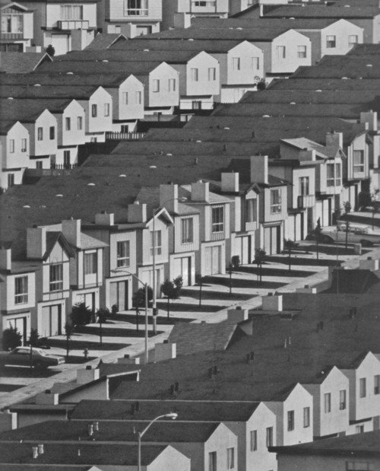
Starting the Journey

Slide 3

The “Default” Architecture

Slide 4
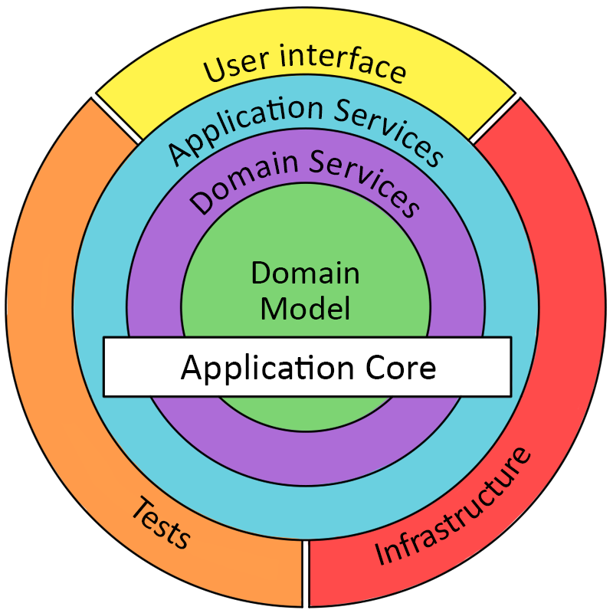
Onion Architecture

Slide 5

The Big Pig

Slide 6
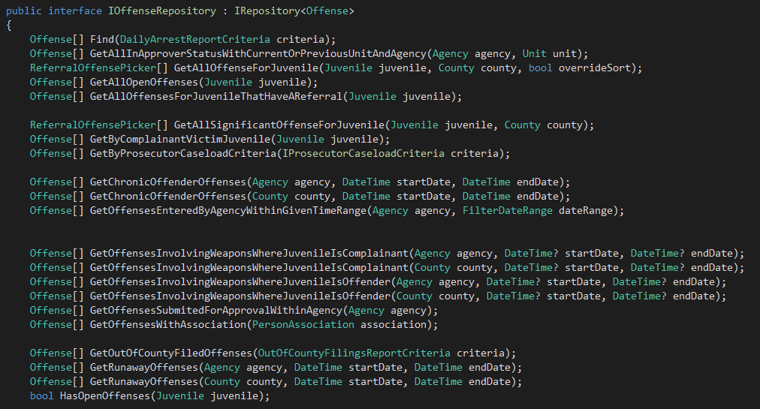
Pattern Happy

Slide 7
Final tally
195 controllers
652 actions
121 roles
218 entities
184 value objects
352 enumerations
~150 deployments

Slide 8

Majestic Monolith Myth

Slide 9
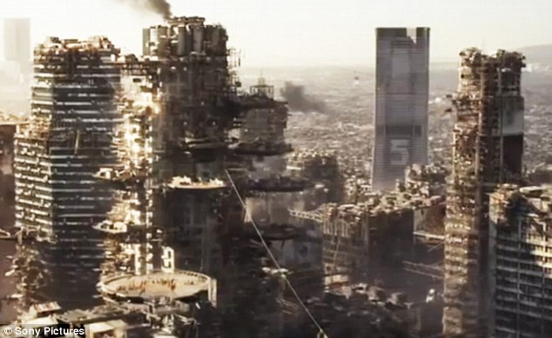
Reality

Slide 10
Successful Architecture Needs Strong Feedback Loops

Slide 11
Teams Need to be Empowered to Make Change

Slide 12

The Failed Journey

Slide 13
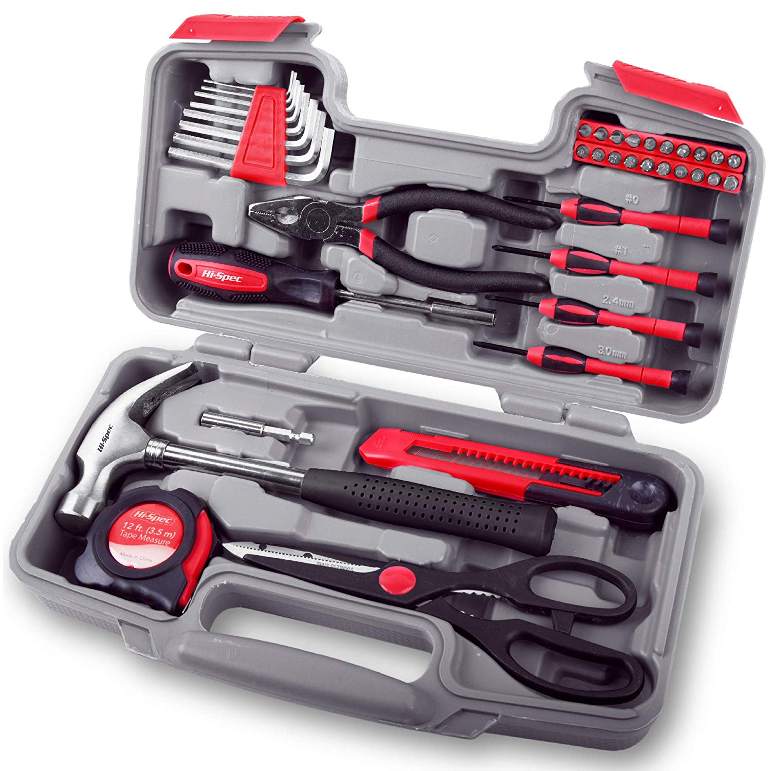
“Right Tool for the Job”

Slide 14



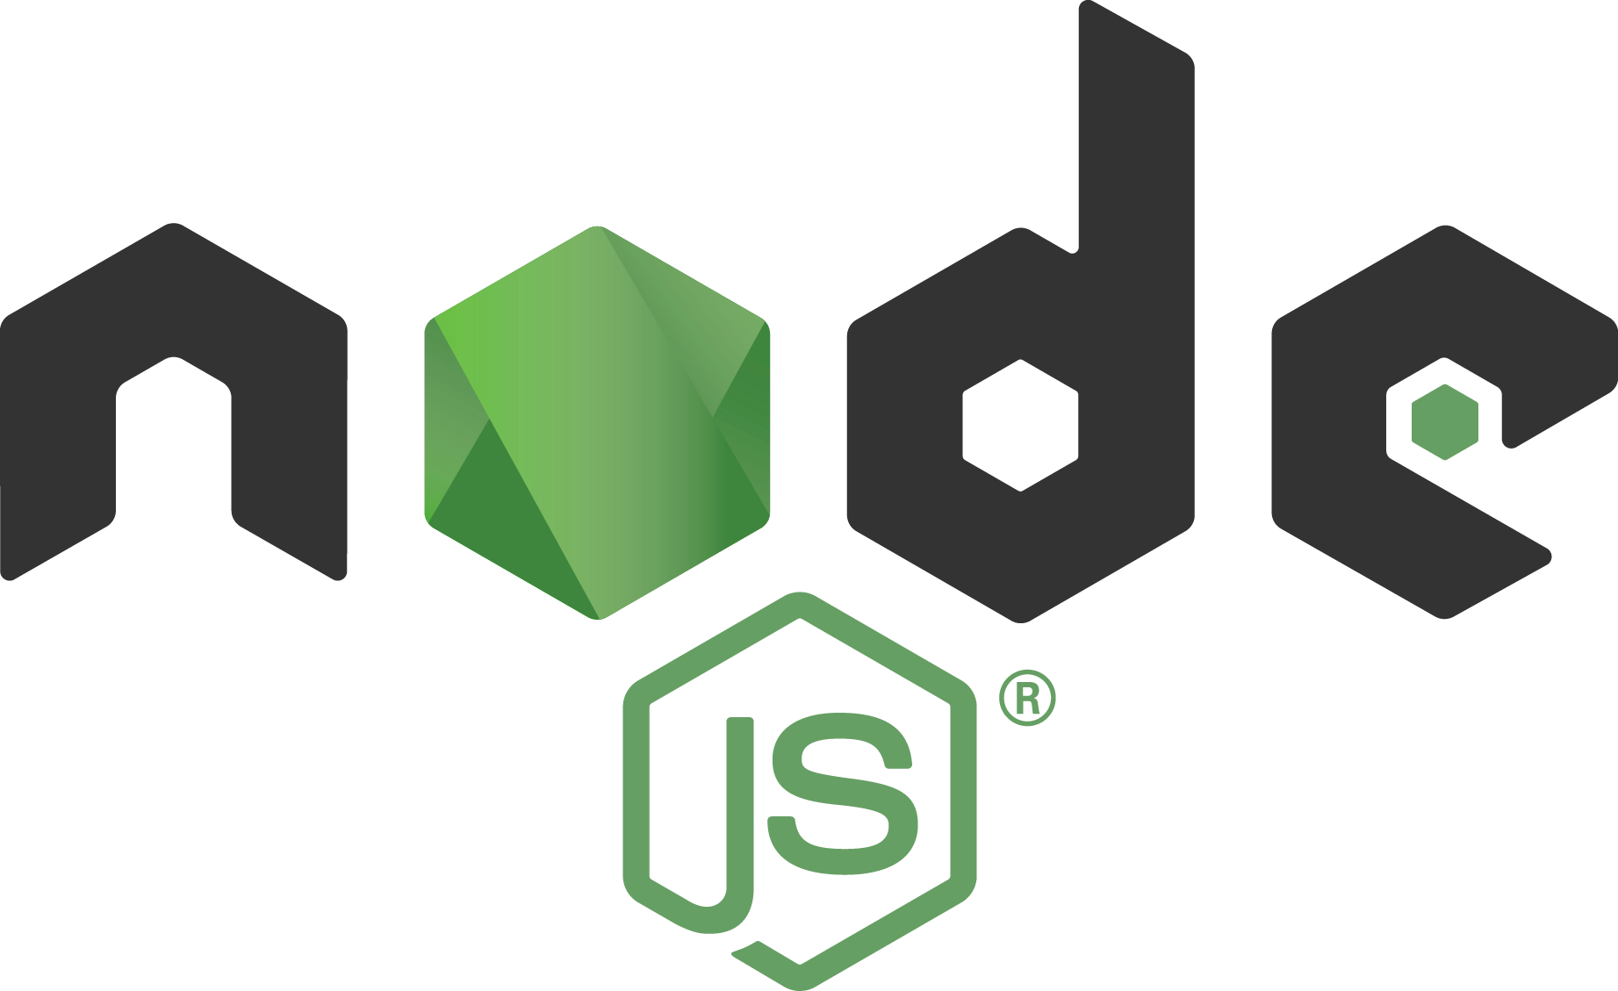

Resume-Driven Development

Slide 15
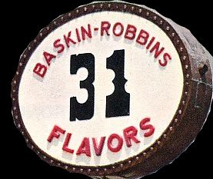

31 Flavors Architecture

Slide 16
Experimentation without Reflection is Chaos

Slide 17
Why Evolutionary Architecture?

Slide 18
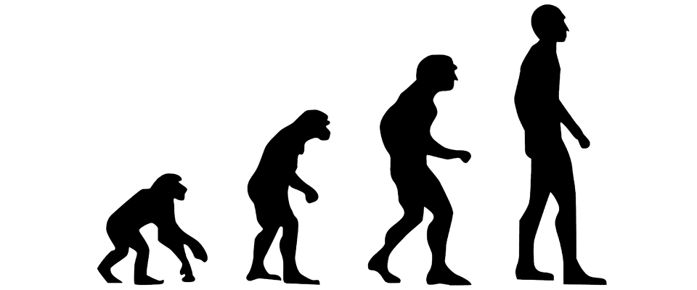
The Only Constant is Change
Notes:
Less risk
New Capabilities

Slide 19
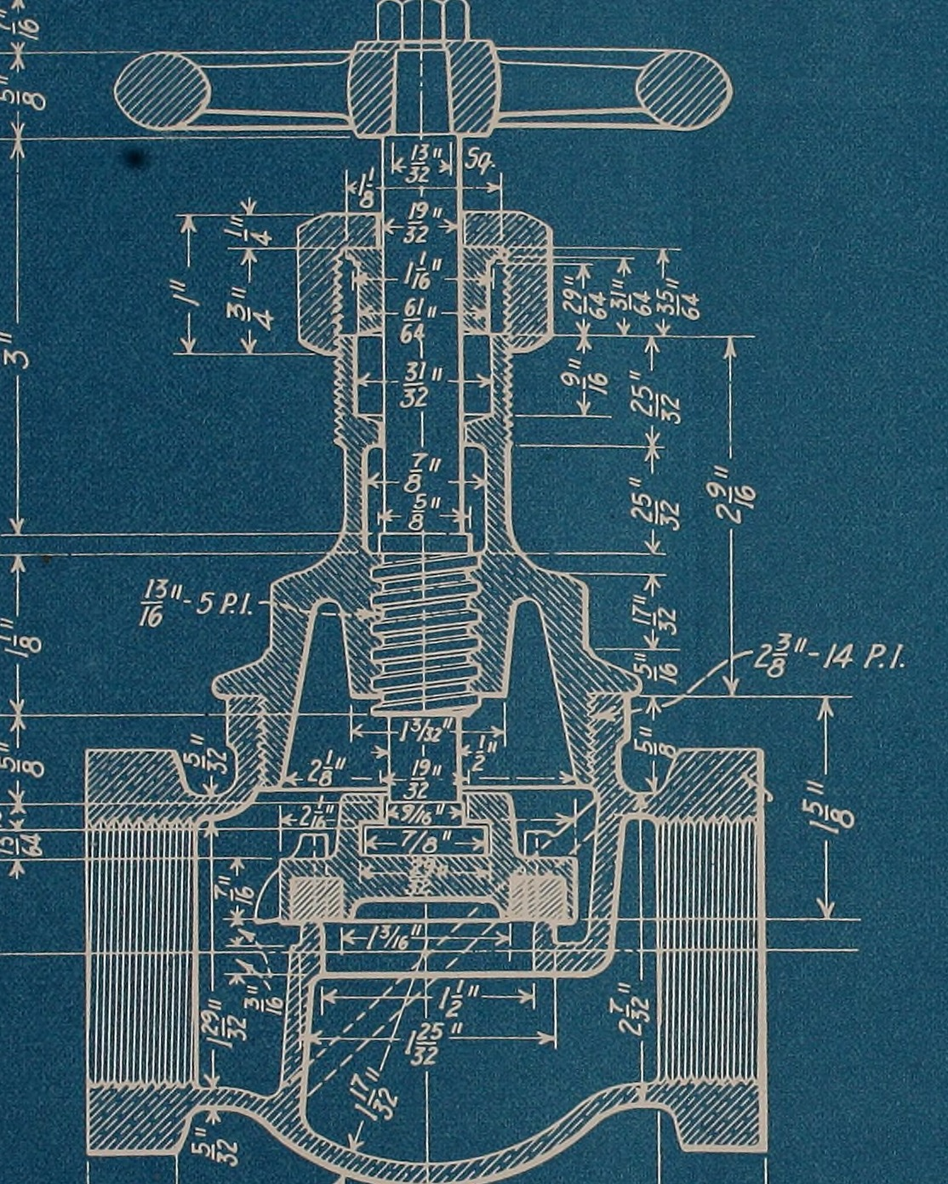
Plan

Slide 20
Underwriting
Accounting
Defining Boundaries
Enterprise Accounts
Claims
Ops

Slide 21
Your boundaries will be wrong! (Plan accordingly)

Slide 22
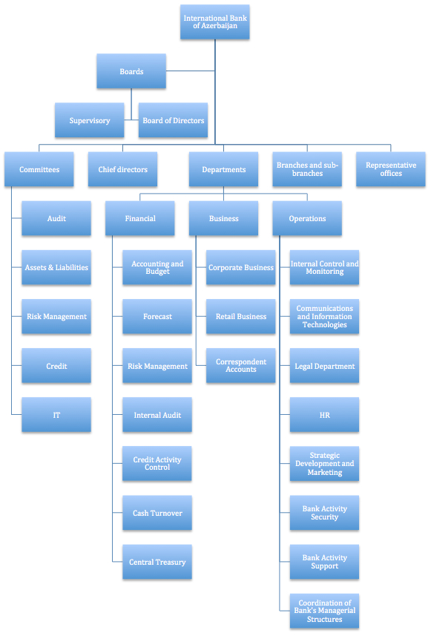
Org Boundary?
(Conway's Law)

Slide 23
Reverse Conway?

Slide 24
Value Chain Alignment

Slide 25
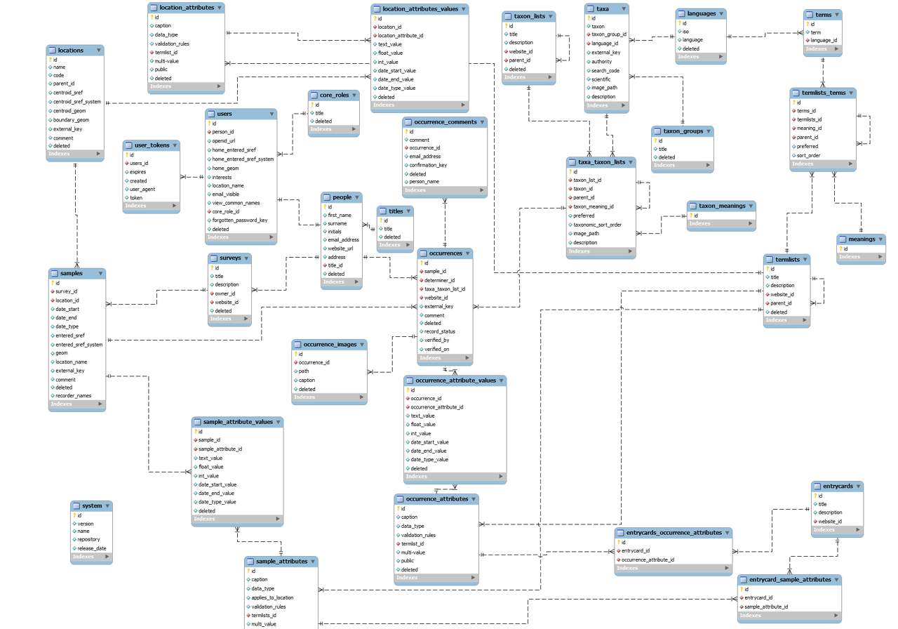
Data Boundaries?
Notes:
Anemic Services

Slide 26
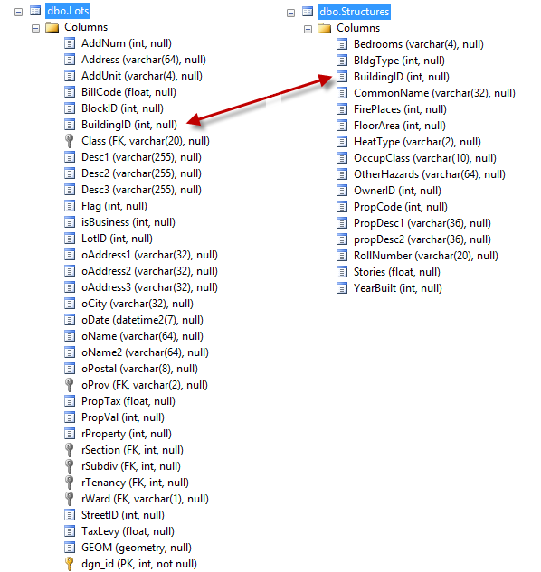
Data Boundary Issues
Notes:
Where to slice? Who reads? Who writes? Which fields? When in the value stream

Slide 27
Volume Manufacturing
Business or Functional Areas?
Discrete Manufacturing
Packing
Sourcing
Shipping
Notes:
Anemic Services

Slide 28
Batch Manufacturing
Discrete Manufacturing
Value Streams?
Procurement
Onboarding
Notes:
Can cross organizations and lead to composition which is a hard problem

Slide 29
Architectural Styles?

Slide 30
Monoliths
Self-Contained Systems
Microservices
Serverless
RPC
SOA
Event-Driven Architecture
Buy vs. Build

Slide 31
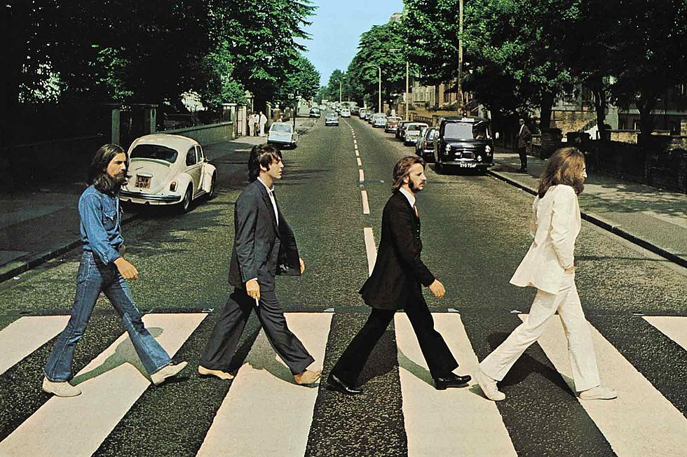

What Defines “Good”?

Slide 32
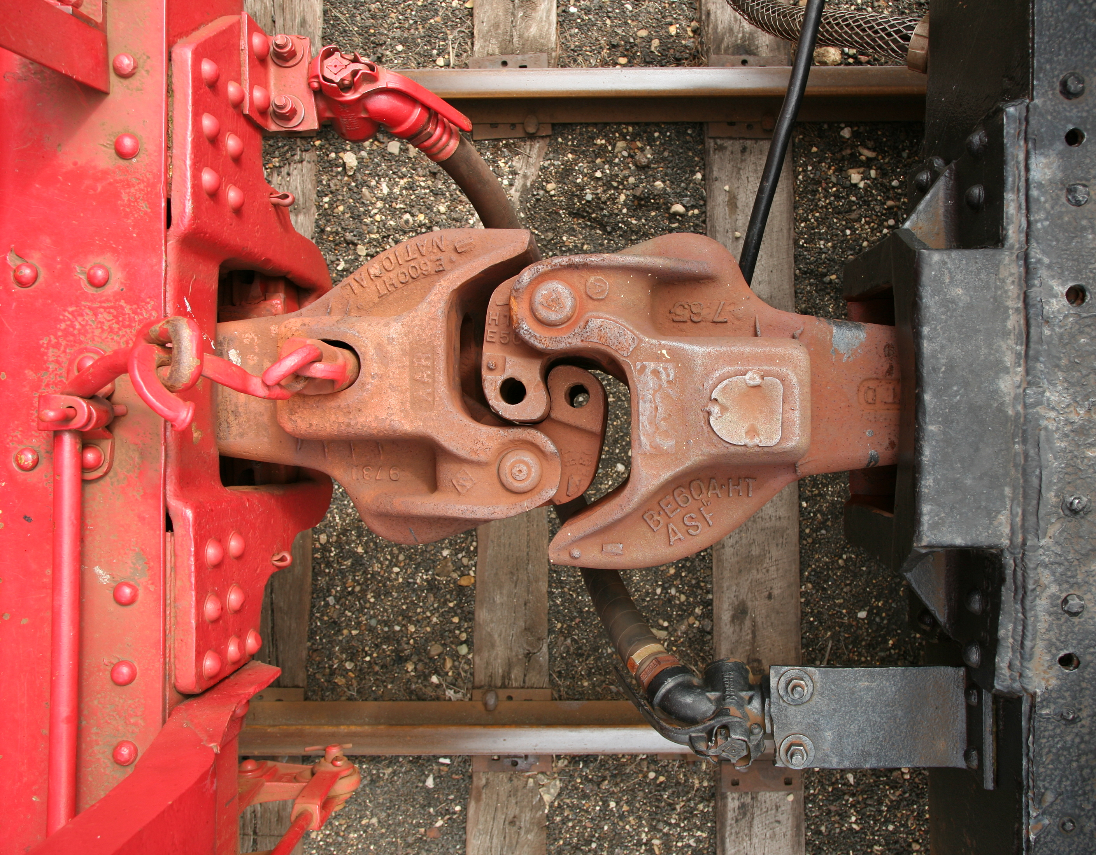
Coupling
Notes:
What is the cost of change

Slide 33
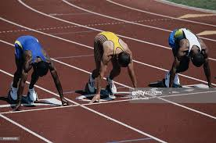
Ground Rules

Slide 34
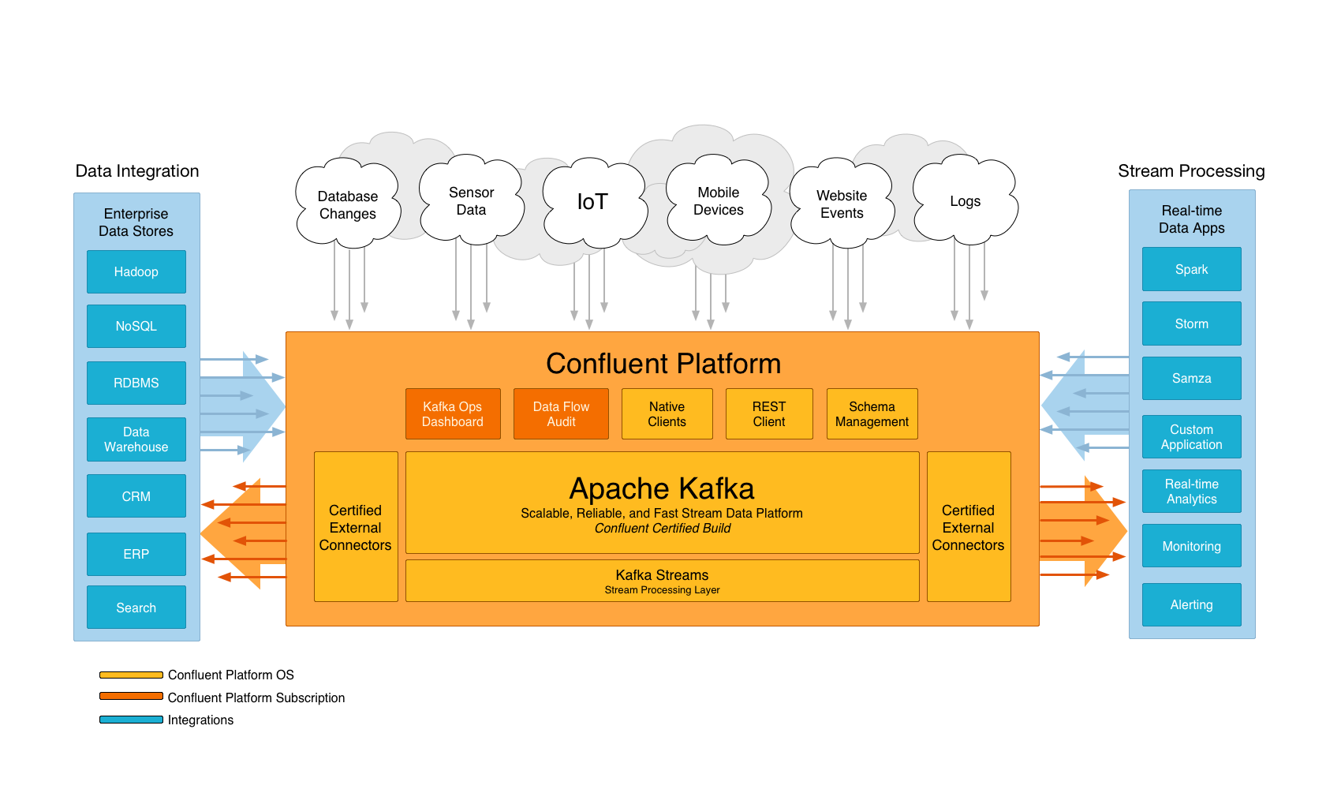
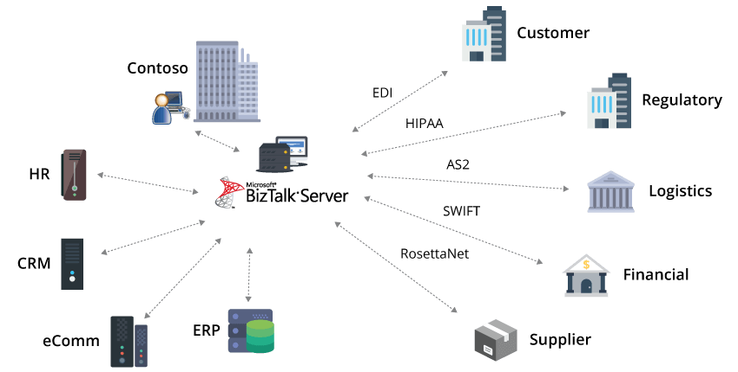
Avoid Vendor Centralization
Notes:
What is the cost of change

Slide 35
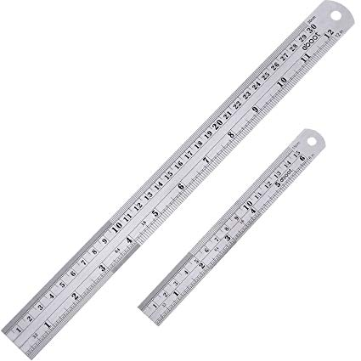
Embrace Standards

Slide 36

Embrace DevOps Culture
Notes:
What is the cost of change

Slide 37
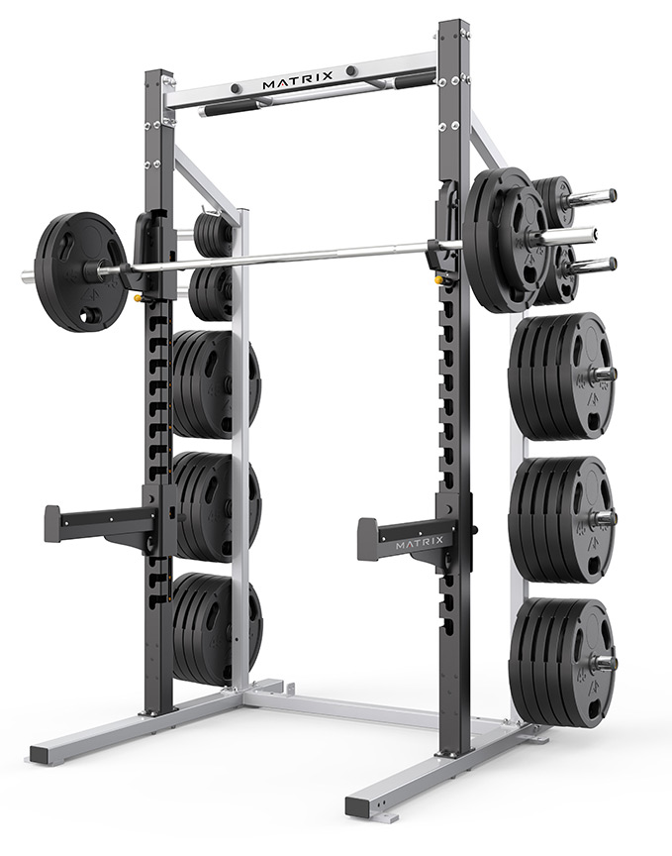
Team Training
Notes:
Have they developed on this platform?
Have they used source control?
Have they done CI?
Have they done CD?
Have they done Agile?
Have they done DevOps?

Slide 38
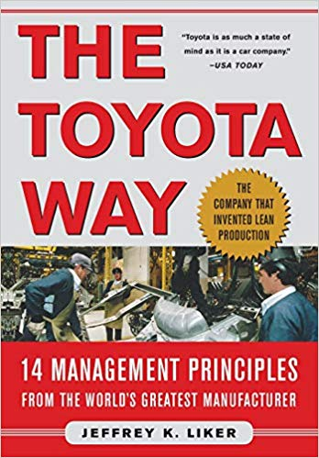
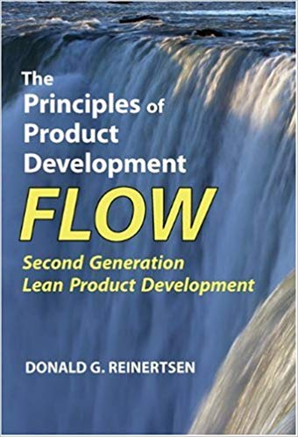
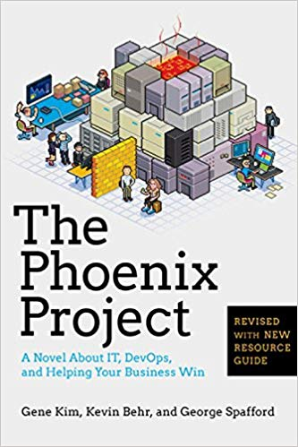
Embrace Lean (in all its forms)

Slide 39
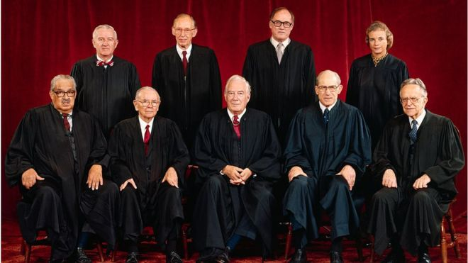
Just In Time Governance
Notes:
Have they developed on this platform?
Have they used source control?
Have they done CI?
Have they done CD?
Have they done Agile?
Have they done DevOps?

Slide 40
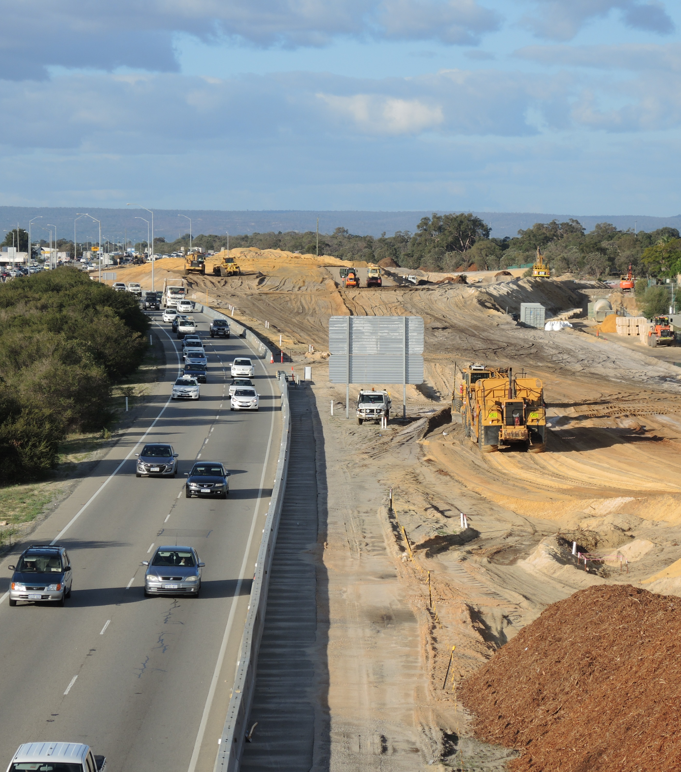
Phased Migration

Slide 41
Staging Teams
Time
Planning
Delivery
Planning
Delivery
Planning
Delivery

Slide 42
Migrating Data Paths
Old
New
Monolith
Notes:
Dual-write
Modify read paths
Modify write paths
Remove old data

Slide 43
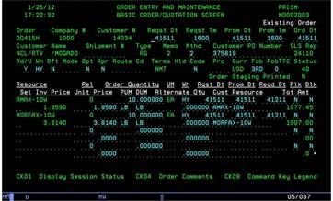
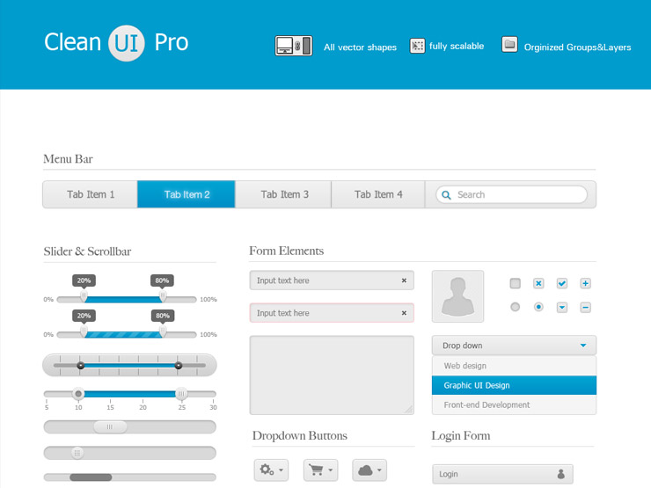
Avoid bidirectional updates

Slide 44
Disabling Functionality
Notes:
Read-only screens. Removing buttons. Removing permissions. Manual processes harder.

Slide 45

Law of Two

Slide 46

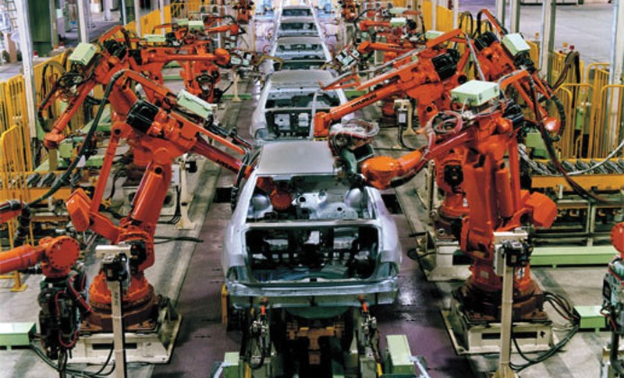
Final Lessons
Embrace change
Compassion over disdain
Product over project
No silver bullets

Slide 47
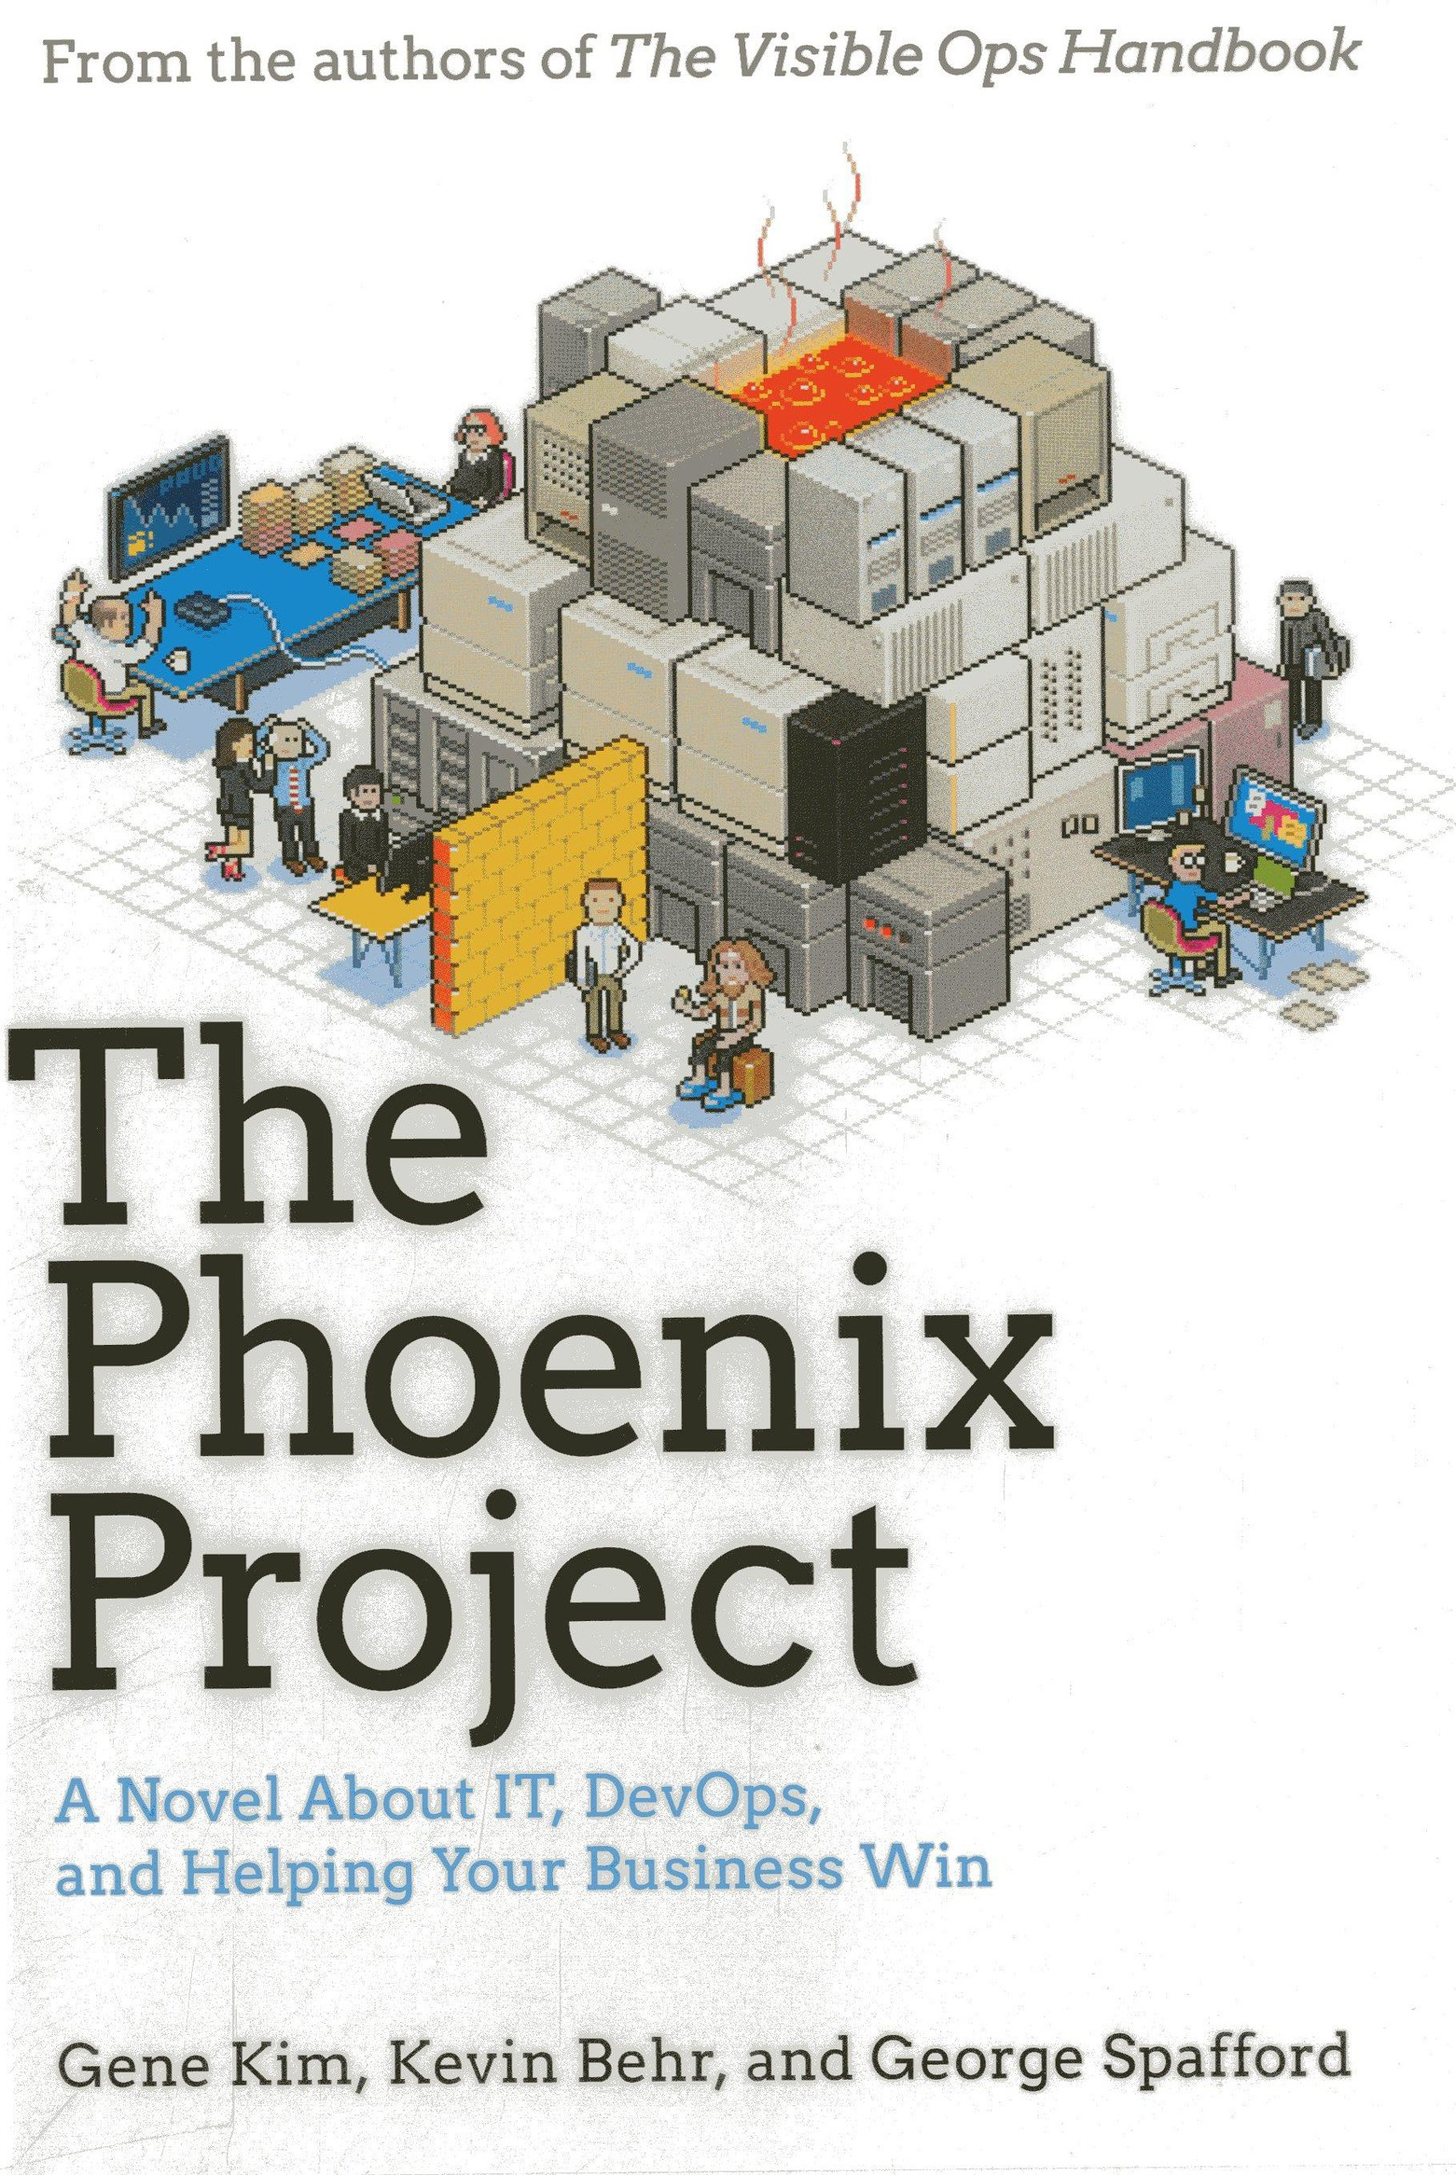
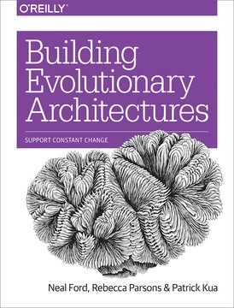
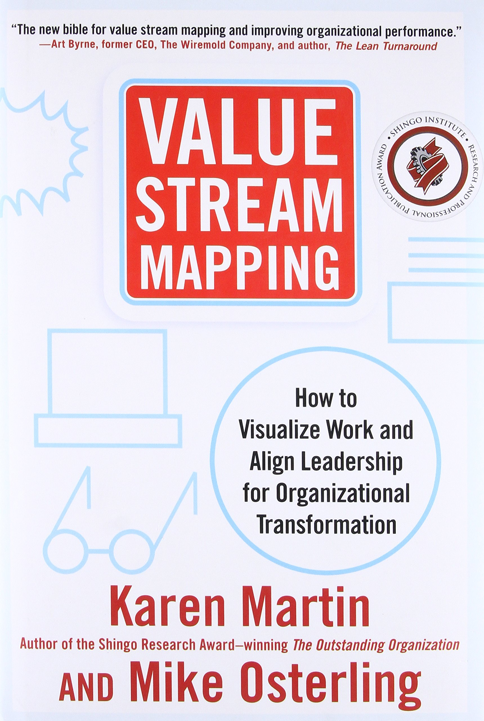
Journey Towards Evolutionary Architecture
Jimmy Bogard
@jbogard
github.com/jbogard/presentations
jimmybogard.com

